Slide 1

Shadow Configurations:
A Network Management Primitive
Richard Alimi, Ye Wang, Y. Richard Yang
Laboratory of Networked Systems
Yale University
February 16, 2009

Slide 2
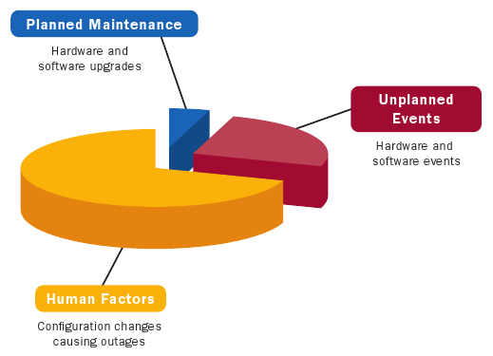
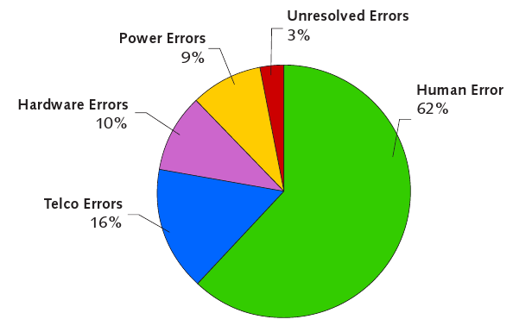
Configuration Leads to Errors
“80% of IT budgets is
used to maintain the status quo.”
“... human error is
blamed for 50-80%
of network outages.”
Source: Juniper Networks, 2008
Source: The Yankee Group, 2004
Why is configuration
hard today?

Slide 3




Configuration Management Today
Hardware
Traffic
Software
iBGP
VPNs
SLAs
Simulation & Analysis
  Depend on
  simplified models
    Network structure
    Hardware and software
  Limited scalability
  Hard to access
  real traffic
Test networks
  Can be prohibitively expensive
OSPF
eBGP
ACLs
TE
Why are these
not enough?

Slide 4


Analogy with Programming
Programming
Program
Network Management
Target
System
Configs
Target
Network
Notes:
To answer this question, let us make two analogies.
First, we will compare network configuration management with programming.
Most people in the audience are programmers.
After we write a program, we test and debug it on the target platform before deployment.
It is hard to imagine deploying a program without first testing and debugging on the target platform.
However, in network management today, configurations are deployed without first testing and debugging on the target network.

Slide 5

Analogy with Databases
Databases
STATE A
INSERT ...
UPDATE ...
DELETE ...
STATE B
INSERT ...
UPDATE ...
Network Management
DELETE ...
STATE A
ip route ...
STATE B
ip addr ...
STATE C
router bgp ...
STATE D
router ospf ...
?
Notes:
Let us next make an analogy with databases.
A major capability in databases is transaction management.
With transactions, a database system can group a sequence of operations and then commit them atomically.
Transient states are not externally visible, and the database system allows the user to rollback if the user is not satisfied with the pending transaction.
However, in today's network management, transient states are immediately visible.
An operator cannot group a set of changes, and then either commit or abort.

Slide 6
Enter, Shadow Configurations
Hardware
Traffic
Software
iBGP
VPNs
SLAs
Key ideas
  Allow additional (shadow)
  config on each router
  In-network, interactive
  shadow environment
  “Shadow” term from
  computer graphics
OSPF
eBGP
ACLs
TE
Key Benefits
  Realistic (no model)
  Scalable
  Access to real traffic
  Transactional

Slide 7
Roadmap
Motivation and Overview
System Basics and Usage
System Components
  Design and Architecture
  Performance Testing
  Transaction Support
Implementation and Evaluation

Slide 8

System Basics
What's in the shadow configuration?
  Routing parameters
  ACLs
  Interface parameters
  VPNs
  QoS parameters
Shadow
config
Real
config
Shadow header
marked “1”
Real header
marked “0”

Slide 9
Example Usage Scenario:
Backup Path Verification
Backup
Primary
Notes:
To illustrate the usefulness of shadow configurations, we will give two example usage scenarios.
In our survey of network operators, one commented that he must periodically verify that a backup path will be followed if a primary link fails.
In the current Internet, he must unplug the link in the operational network to accomplish this.
In his scenario, however, the backup path has limited capacity, and this may cause congestion for operational traffic.
Shadow configurations provides a solution that does not disrupt the operational network.
[DISCUSS]

Slide 10
Example Usage Scenario:
Backup Path Verification
Send test packets in shadow
Notes:
To illustrate the usefulness of shadow configurations, we will give two example usage scenarios.
In our survey of network operators, one commented that he must periodically verify that a backup path will be followed if a primary link fails.
In the current Internet, he must unplug the link in the operational network to accomplish this.
In his scenario, however, the backup path has limited capacity, and this may cause congestion for operational traffic.
Shadow configurations provides a solution that does not disrupt the operational network.
[DISCUSS]

Slide 11

Example Usage Scenario:
Backup Path Verification
Disable
shadow link
X
X
Notes:
To illustrate the usefulness of shadow configurations, we will give two example usage scenarios.
In our survey of network operators, one commented that he must periodically verify that a backup path will be followed if a primary link fails.
In the current Internet, he must unplug the link in the operational network to accomplish this.
In his scenario, however, the backup path has limited capacity, and this may cause congestion for operational traffic.
Shadow configurations provides a solution that does not disrupt the operational network.
[DISCUSS]

Slide 12
Example Usage Scenario:
Backup Path Verification
Notes:
To illustrate the usefulness of shadow configurations, we will give two example usage scenarios.
In our survey of network operators, one commented that he must periodically verify that a backup path will be followed if a primary link fails.
In the current Internet, he must unplug the link in the operational network to accomplish this.
In his scenario, however, the backup path has limited capacity, and this may cause congestion for operational traffic.
Shadow configurations provides a solution that does not disrupt the operational network.
[DISCUSS]

Slide 13

Example Usage Scenario:
Configuration Evaluation
Video Server
Notes:
We next present a usage scenario where an ISP would like to test the effects of a set of OSPF link-weight changes on streaming traffic.
In the current Internet, there is no way to perform a realistic evaluation before deployment.
The ISP could make the changes directly to the operational network. However, if the changes are ineffective, this can cause disruption to operational traffic.
Shadow configurations provide the ability to realistically evaluate the set of OSPF link-weight changes without disrupting operational traffic.
[DISCUSS]
Some of you may make 2 observations.
First, duplicating streaming traffic from the real configuration into the shadow configuration is a major testing advantage. But, if the streaming traffic volume is high, then the combined traffic may overload some links.
Second, though shadow configurations allows us to validate the effectiveness of the new configuration, when the routers switch to the new configuration, there still will be a routing reconvergence process, which can cause disruption to streaming traffic.
We present solutions to both of these issues.

Slide 14
Example Usage Scenario:
Configuration Evaluation
Video Server
Notes:
We next present a usage scenario where an ISP would like to test the effects of a set of OSPF link-weight changes on streaming traffic.
In the current Internet, there is no way to perform a realistic evaluation before deployment.
The ISP could make the changes directly to the operational network. However, if the changes are ineffective, this can cause disruption to operational traffic.
Shadow configurations provide the ability to realistically evaluate the set of OSPF link-weight changes without disrupting operational traffic.
[DISCUSS]
Some of you may make 2 observations.
First, duplicating streaming traffic from the real configuration into the shadow configuration is a major testing advantage. But, if the streaming traffic volume is high, then the combined traffic may overload some links.
Second, though shadow configurations allows us to validate the effectiveness of the new configuration, when the routers switch to the new configuration, there still will be a routing reconvergence process, which can cause disruption to streaming traffic.
We present solutions to both of these issues.

Slide 15
Example Usage Scenario:
Configuration Evaluation
Video Server
Duplicate packets to shadow
Notes:
We next present a usage scenario where an ISP would like to test the effects of a set of OSPF link-weight changes on streaming traffic.
In the current Internet, there is no way to perform a realistic evaluation before deployment.
The ISP could make the changes directly to the operational network. However, if the changes are ineffective, this can cause disruption to operational traffic.
Shadow configurations provide the ability to realistically evaluate the set of OSPF link-weight changes without disrupting operational traffic.
[DISCUSS]
Some of you may make 2 observations.
First, duplicating streaming traffic from the real configuration into the shadow configuration is a major testing advantage. But, if the streaming traffic volume is high, then the combined traffic may overload some links.
Second, though shadow configurations allows us to validate the effectiveness of the new configuration, when the routers switch to the new configuration, there still will be a routing reconvergence process, which can cause disruption to streaming traffic.
We present solutions to both of these issues.

Slide 16
Roadmap
Motivation and Overview
System Basics and Usage
System Components
  Design and Architecture
  Performance Testing
  Transaction Support
Implementation and Evaluation

Slide 17
Design and Architecture
Management
Configuration UI
Control Plane
OSPF
BGP
IS-IS
Forwarding Engine
FIB
Interface0
Interface1
Interface2
Interface3

Slide 18
Design and Architecture
Management
Configuration UI
Control Plane
OSPF
BGP
IS-IS
Forwarding Engine
Shadow-enabled FIB
Shadow Bandwidth Control
Interface0
Interface1
Interface2
Interface3

Slide 19
Design and Architecture
Management
Configuration UI
Control Plane
OSPF
Shadow Management
OSPF
BGP
Commitment
BGP
IS-IS
IS-IS
Forwarding Engine
Shadow-enabled FIB
Shadow Bandwidth Control
Interface0
Interface1
Interface2
Interface3

Slide 20
Design and Architecture
Management
Debugging Tools
Configuration UI
Shadow Traffic Control
FIB Analysis
Control Plane
OSPF
Shadow Management
OSPF
BGP
Commitment
BGP
IS-IS
IS-IS
Forwarding Engine
Shadow-enabled FIB
Shadow Bandwidth Control
Interface0
Interface1
Interface2
Interface3

Slide 21
Design and Architecture
Management
Debugging Tools
Configuration UI
Shadow Traffic Control
FIB Analysis
Control Plane
OSPF
Shadow Management
OSPF
BGP
Commitment
BGP
IS-IS
IS-IS
Forwarding Engine
Shadow-enabled FIB
Shadow Bandwidth Control
Interface0
Interface1
Interface2
Interface3

Slide 22
Shadow Bandwidth Control
Requirements
  Minimal impact on real traffic
  Accurate performance measurements of shadow configuration
Supported Modes
  Priority
  Bandwidth Partitioning
  Packet Cancellation
Notes:
Let us first look at ShadowBandwidth Control.
This component has two major requirements.
First, the presence of the shadow configuration should have minimal impact on the operational network.
Second, we should be able to collect reasonably-accurate measurements from the shadow configuration despite the presence of operational traffic.
We support 3 modes for shadow bandwidth control.
Priority, which gives real traffic higher priority.
The advantage is minimal impact on real traffic, but a potential issue is that the performance measurements from the shadow configuration can be less accurate.
Bandwidth Partitioning, where the shadow configuration can use non-work conserving scheduling to provide “scaled-down” testing bandwidth and arrival processes.
A potential issue, however, is that it does not allow us to conduct stress tests in the shadow configuration when the the volume of the operational traffic and shadow traffic is high.
One example scenario is the streaming usage scenario, when the real traffic volume is high, and we divert real traffic into the shadow configuration.
We handle such scenarios using Packet Cancellation.

Slide 23
Packet Cancellation
Observation: in many network performance
testing scenarios,
  Content of payload is not important
  Only payload size matters
Idea: only need headers for shadow traffic
Piggyback shadow
headers on real
packets
Piggybacked
shadow
header

Slide 24
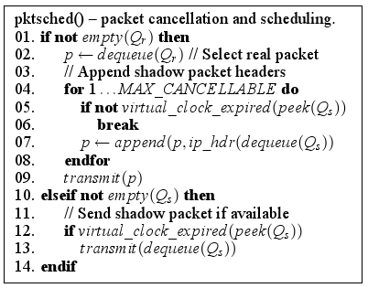
Packet Cancellation Details
Output interface maintains real and shadow queues
  Qr and Qs

Slide 25
Packet Cancellation Details
Output interface maintains real and shadow queues
  Qr and Qs

Slide 26
Packet Cancellation Details
Output interface maintains real and shadow queues
  Qr and Qs

Slide 27
Packet Cancellation Details
Output interface maintains real and shadow queues
  Qr and Qs

Slide 28
Forwarding Overhead
Without Packet Cancellation:
IP
Lookup
With Packet Cancellation:
IP
Lookup
Cancellation may require routers to process more packets.
Can routers support it?

Slide 29


Forwarding Overhead Analysis
Routers can be designed for worst-case
  L : Link speed
  Kmin : Minimum packet size
  Router supports packets per second
Load typically measured by link utilization
  αr : Utilization due to real traffic (packet sizes kr )
  αs : Utilization due to shadow traffic (packet sizes ks )
We require:

Slide 30
Forwarding Overhead Analysis
Routers can be designed for worst-case
  L : Link speed
  Kmin : Minimum packet size
  Router supports packets per second
Load typically measured by link utilization
  αr : Utilization due to real traffic (packet sizes kr )
  αs : Utilization due to shadow traffic (packet sizes ks )
We require:
Example:
With α = 70%, and 80% real traffic utilization
Support up to 75% shadow traffic utilization

Slide 31
Commitment
Objectives
  Smoothly swap real and shadow across network
    Eliminate effects of reconvergence due to config changes
  Easy to swap back

Slide 32
Commitment
Objectives
  Smoothly swap real and shadow across network
    Eliminate effects of reconvergence due to config changes
  Easy to swap back
Issue
  Packet marked with shadow bit
    0 = Real, 1 = Shadow
  Shadow bit determines which FIB to use
  Routers swap FIBs asynchronously
  Inconsistent FIBs applied on the path

Slide 33
Commitment Protocol
Idea: Use tags to achieve consistency
  Temporary identifiers
Basic algorithm has 4 phases

Slide 34
Commitment Protocol
Idea: Use tags to achieve consistency
  Temporary identifiers
Basic algorithm has 4 phases
  Distribute tags for each config
    C-old for current real config
    C-new for current shadow config
0: C-old
1: C-new
0
0
0
0
1
0
1
0
1
0
1
1
0

Slide 35
Commitment Protocol
Idea: Use tags to achieve consistency
  Temporary identifiers
Basic algorithm has 4 phases
  Distribute tags for each config
    C-old for current real config
    C-new for current shadow config
  Routers mark packets with tags
    Packets forwarded according to tags
C-old
0
C-old
C-old
C-old
C-new
C-old
C-new
0
1
0
1
C-old
C-new
0
1
C-old
C-new
C-new
C-old

Slide 36
Commitment Protocol
Idea: Use tags to achieve consistency
  Temporary identifiers
Basic algorithm has 4 phases
  Distribute tags for each config
    C-old for current real config
    C-new for current shadow config
  Routers mark packets with tags
    Packets forwarded according to tags
  Swap configs (tags still valid)
0: C-new
1: C-old
C-old
1
C-old
C-old
C-old
C-new
C-old
C-new
1
0
1
0
C-old
C-new
1
0
C-old
C-new
C-new
C-old

Slide 37
Commitment Protocol
Idea: Use tags to achieve consistency
  Temporary identifiers
Basic algorithm has 4 phases
  Distribute tags for each config
    C-old for current real config
    C-new for current shadow config
  Routers mark packets with tags
    Packets forwarded according to tags
  Swap configs (tags still valid)
  Remove tags from packets
    Resume use of shadow bit
1
1
0
1
0
0
1
0
0

Slide 38
Commitment Protocol
Idea: Use tags to achieve consistency
  Temporary identifiers
Basic algorithm has 4 phases
  Distribute tags for each config
    C-old for current real config
    C-new for current shadow config
  Routers mark packets with tags
    Packets forwarded according to tags
  Swap configs (tags still valid)
  Remove tags from packets
    Resume use of shadow bit
1
1
0
1
0
0
1
0
0

Slide 39
Transient States
Definition: State in which some packets use C-old and others use C-new.
C-old
Transient
State
C-new
C-old
C-new

Slide 40
Transient States
Definition: State in which some packets use C-old and others use C-new.
C-old
C-new
C-old
C-new
C-old
C-new

Slide 41
Transient States
Definition: State in which some packets use C-old and others use C-new.
C-old
C-new
C-old
C-new
C-new
C-old
Possible overutilization!
Should be short-lived, even with errors

Slide 42
Error Recovery During Swap
If ACK missing from at least one router, two cases:
  Router completed SWAP but ACK not sent
  Router did not complete SWAP
Transient State
C-new
C-old

Slide 43
Error Recovery During Swap
If ACK missing from at least one router, two cases:
  Router completed SWAP but ACK not sent
  Router did not complete SWAP
Detect (b) and rollback quickly
  Querying router directly may be impossible
Transient State
C-new
C-old

Slide 44
Error Recovery During Swap
If ACK missing from at least one router, two cases:
  Router completed SWAP but ACK not sent
  Router did not complete SWAP
Detect (b) and rollback quickly
  Querying router directly may be impossible
Solution: Ask neighboring routers
Transient State
C-new
If YES:
Case (b): rollback other routers
Otherwise,
Case (a): no transient state
C-old
Do you see C-old data packets?

Slide 45
Roadmap
Motivation and Overview
System Basics and Usage
System Components
  Design and Architecture
  Performance Testing
  Transaction Support
Implementation and Evaluation

Slide 46
Implementation
Kernel-level (based on Linux 2.6.22.9)
  TCP/IP stack support
  FIB management
  Commitment hooks
  Packet cancellation
Tools
  Transparent software router support (Quagga + XORP)
  Full commitment protocol
  Configuration UI (command-line based)
Evaluated on Emulab (3Ghz HT CPUs)

Slide 47
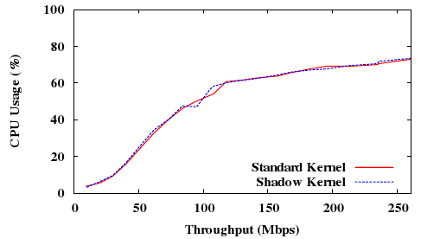
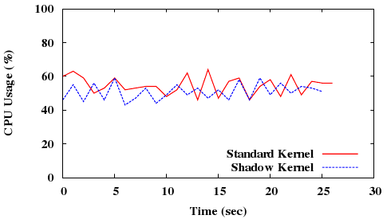
Evaluation: CPU Overhead
Static FIB
  300B pkts
  No route caching
With FIB updates
  300B pkts @ 100Mbps
  1-100 updates/sec
  No route caching

Slide 48
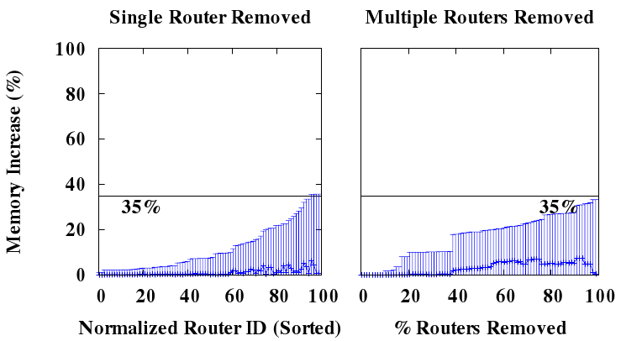
Evaluation: Memory Overhead
FIB storage overhead for US Tier-1 ISP

Slide 49
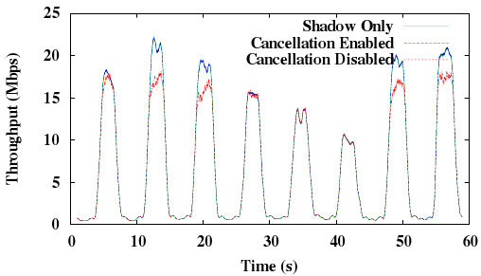
Evaluation: Packet Cancellation
Accurate streaming throughput measurement
  Abilene topology
  Real transit traffic duplicated to shadow
  Video streaming traffic in shadow

Slide 50
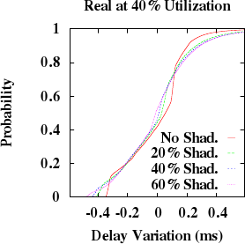
Evaluation: Packet Cancellation
Limited interaction of real and shadow
  Intersecting real and shadow flows
    CAIDA traces
  Vary flow utilizations

Slide 51
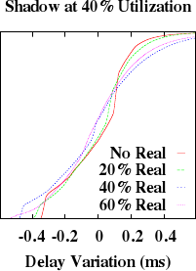
Evaluation: Packet Cancellation
Limited interaction of real and shadow
  Intersecting real and shadow flows
    CAIDA traces
  Vary flow utilizations

Slide 52
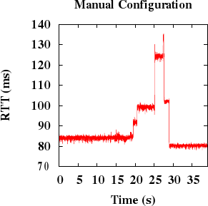
Evaluation: Commitment
Applying OSPF link-weight changes
  Abilene topology with 3 external peers
    Configs translated to Quagga syntax
    Abilene BGP dumps

Slide 53
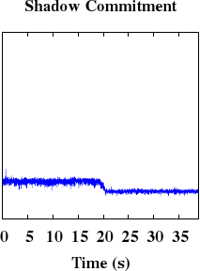
Evaluation: Commitment
Reconvergence in shadow
Applying OSPF link-weight changes
  Abilene topology with 3 external peers
    Configs translated to Quagga syntax
    Abilene BGP dumps

Slide 54
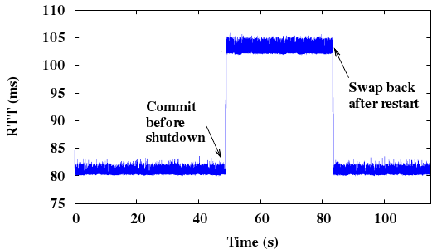
Evaluation: Router Maintenance
Temporarily shutdown router
  Abilene topology with 3 external peers
    Configs translated to Quagga syntax
    Abilene BGP dumps

Slide 55
Evaluation: Router Maintenance
41 ms latency
Temporarily shutdown router
  Abilene topology with 3 external peers
    Configs translated to Quagga syntax
    Abilene BGP dumps
C-old
C-new
51 ms latency

Slide 56
Conclusion and Future Work
Shadow configurations is new management primitive
  Realistic in-network evaluation
  Network-wide transactional support for configuration
Future work
  Evaluate on carrier-grade installations
  Automated proactive testing
  Automated reactive debugging

Slide 57
Thank you!

